Slide 1

Stock Analysis
Corey Zhang
West Chester University of Pennsylvania

Slide 2
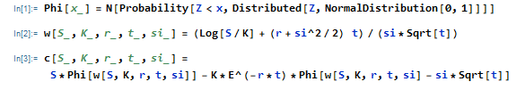
Black-Scholes Equation

Slide 3


Microsoft Corporation (MSFT)
Microsoft Corporation develops, licenses, and supports software, services, devices, and solutions worldwide.
Product: Microsoft Office, Outlook, Skype, LinkedIn, etc.

Slide 4
Microsoft Corporation (MSFT)
1/1/2021

Slide 5
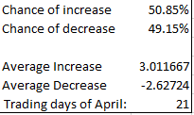
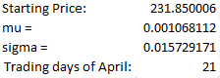
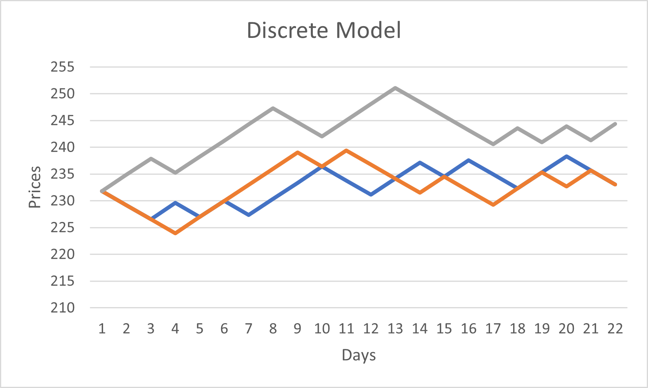
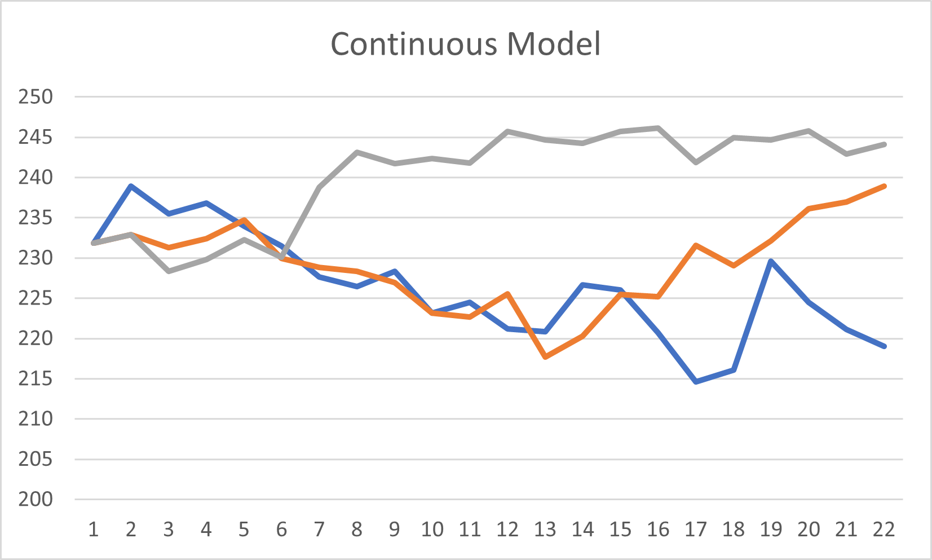
Microsoft Corporation (MSFT)
Models for April

Slide 6
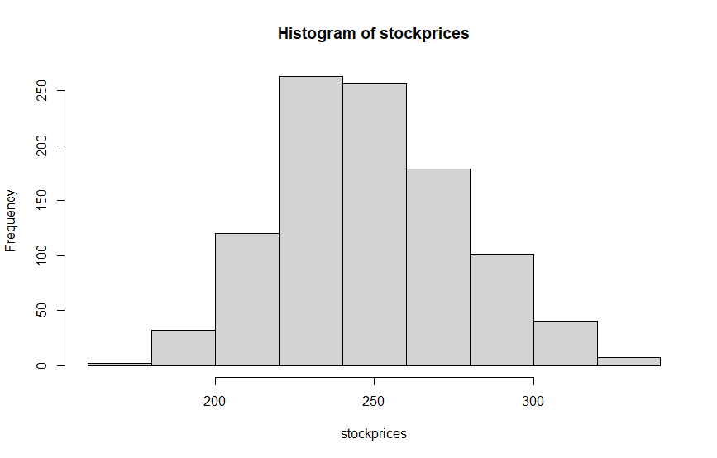
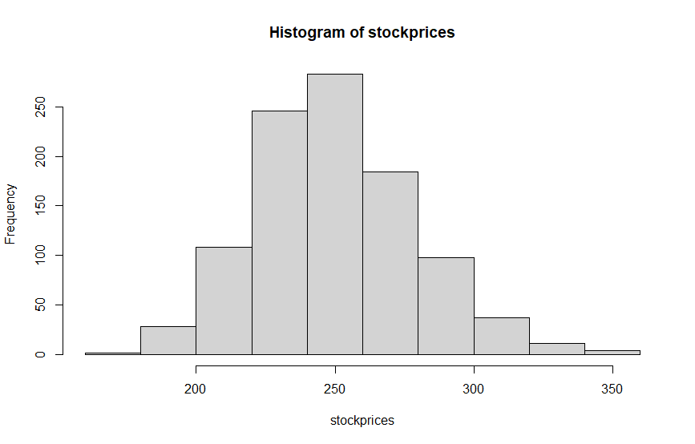
Microsoft Corporation (MSFT)
After 1000 runs to predict the price of 4/23/21
Discrete Model
Mean: 240.27
Std: 11.39
Continuous Model
Mean: 248.28
Std: 28.46
Discrete Model
Continuous Model

Slide 7
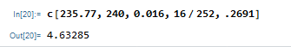
Microsoft Corporation (MSFT)
Stock Closing Price on 3/31/2021: $235.77
Average Annual Volatility: 26.91%
Risk Free rate of return: 1.6%
T = 16/252
K = 240
Black-Scholes Price: $4.63
Listed price: $3.8
Actual Price of 4/23: $237.49

Slide 8
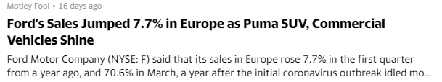

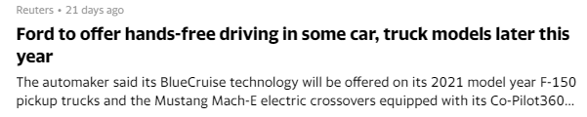
Ford Motor Company(F)
Ford Motor Company designs, manufactures, markets, and services a range of Ford trucks, cars, sport utility vehicles, electrified vehicles, and Lincoln luxury vehicles worldwide.

Slide 9
Ford Motor Company(F)
1/1/2021
3/31/2021

Slide 10
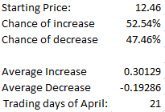
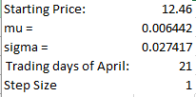
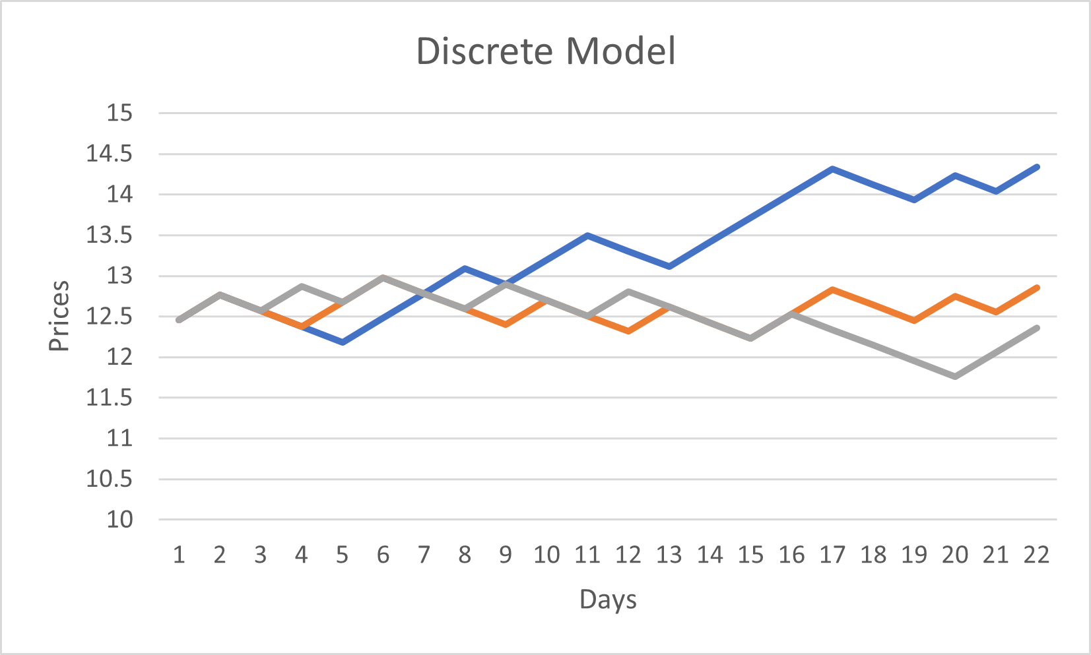
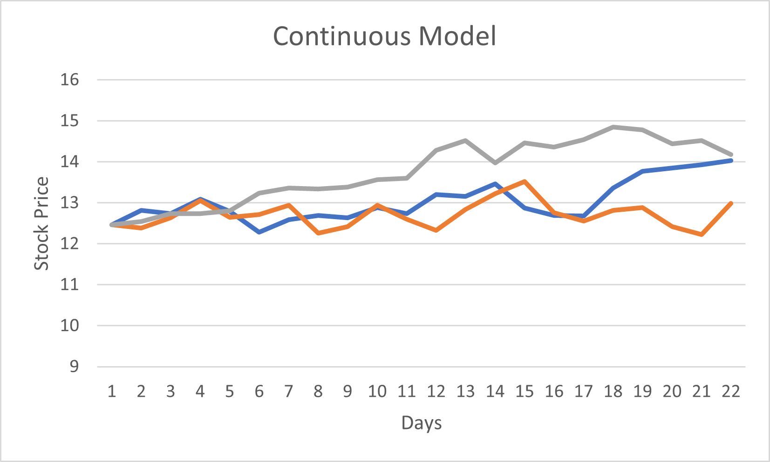
Ford Motor Company(F)
Models for April

Slide 11
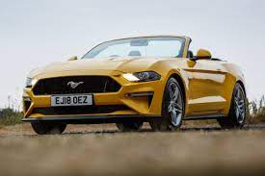
Ford Motor Company(F)
After 1000 runs to predict the price of 4/23/21
Discrete Model
Mean: 13.55
Std: 0.95
Continuous Model
Mean: 13.05
Std: 1.27

Slide 12
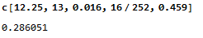
Ford Motor Company(F)
Stock Closing Price on 3/31/2019: $12.25
Average Annual Volatility: 45.9%
Risk Free rate of return: 1.6%
T = 16/252
K = 13
Black-Scholes Price: $0.29
Listed price: $0.13
Actual Price of 4/23: $11.97

Slide 13

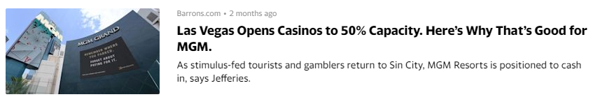
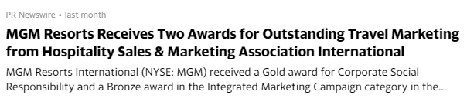
MGM Resorts International(MGM)
MGM Resorts International, through its subsidiaries, owns and operates casino, hotel, and entertainment resorts in the United States and Macau. The company operates through three segments: Las Vegas Strip Resorts, Regional Operations, and MGM China. Its casino resorts offer gaming, hotel, convention, dining, entertainment, retail, and other resort amenities. The company's casino operations include slots and table games, as well as online sports betting and iGaming through BetMGM.

Slide 14
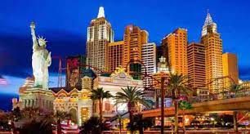
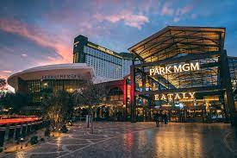
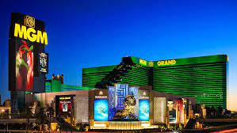
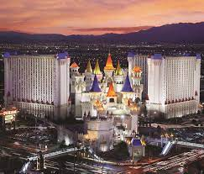
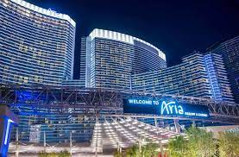
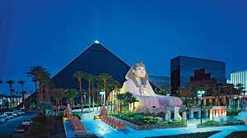
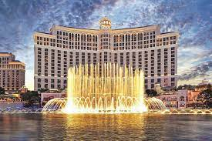
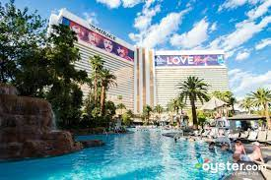
New York- New York
MGM Park
MGM Grand
Aria
Excalibur
Luxor
Bellagio
Mirage

Slide 15

MGM Resorts International(MGM)
1/1/2021
3/31/2021

Slide 16
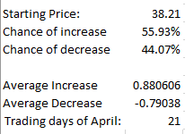
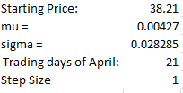
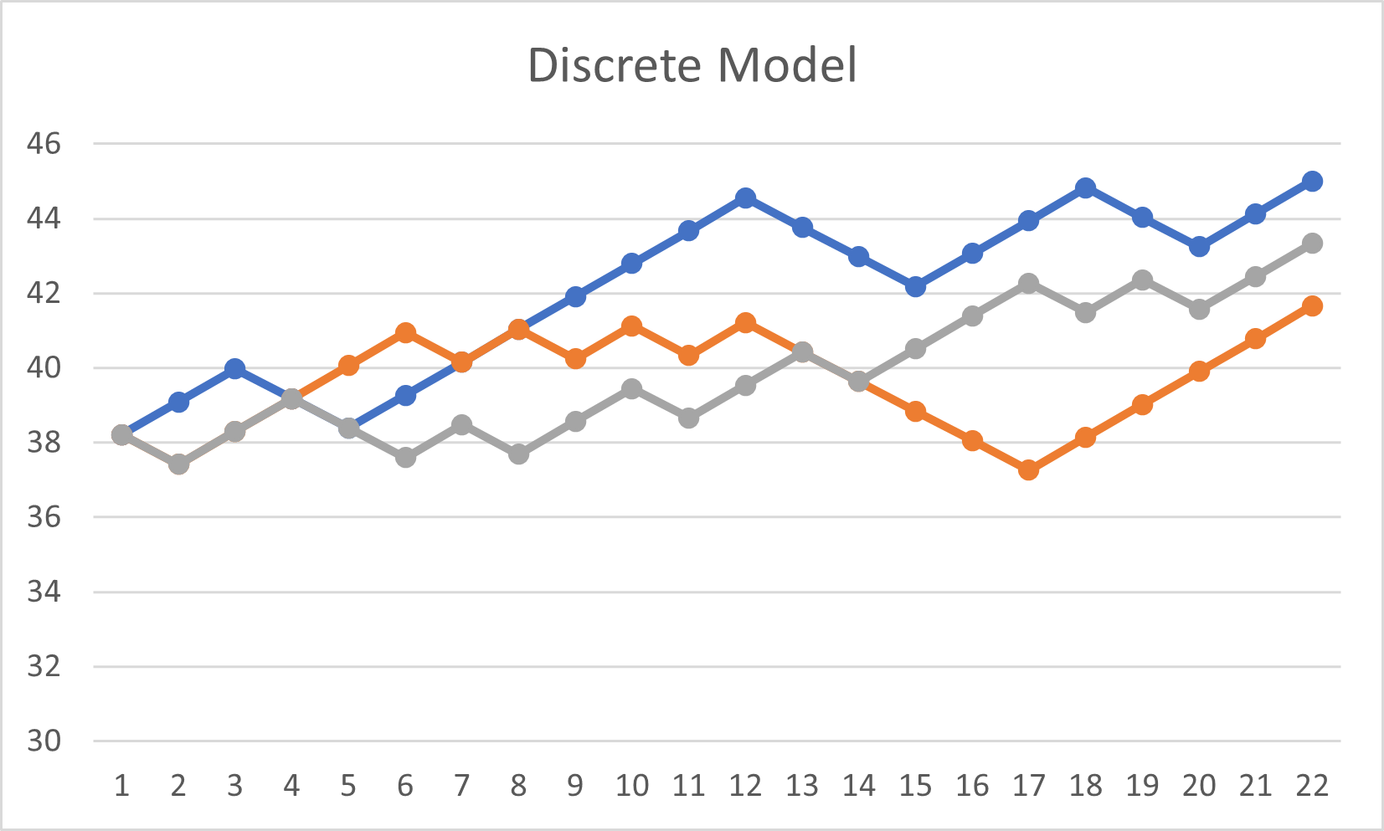
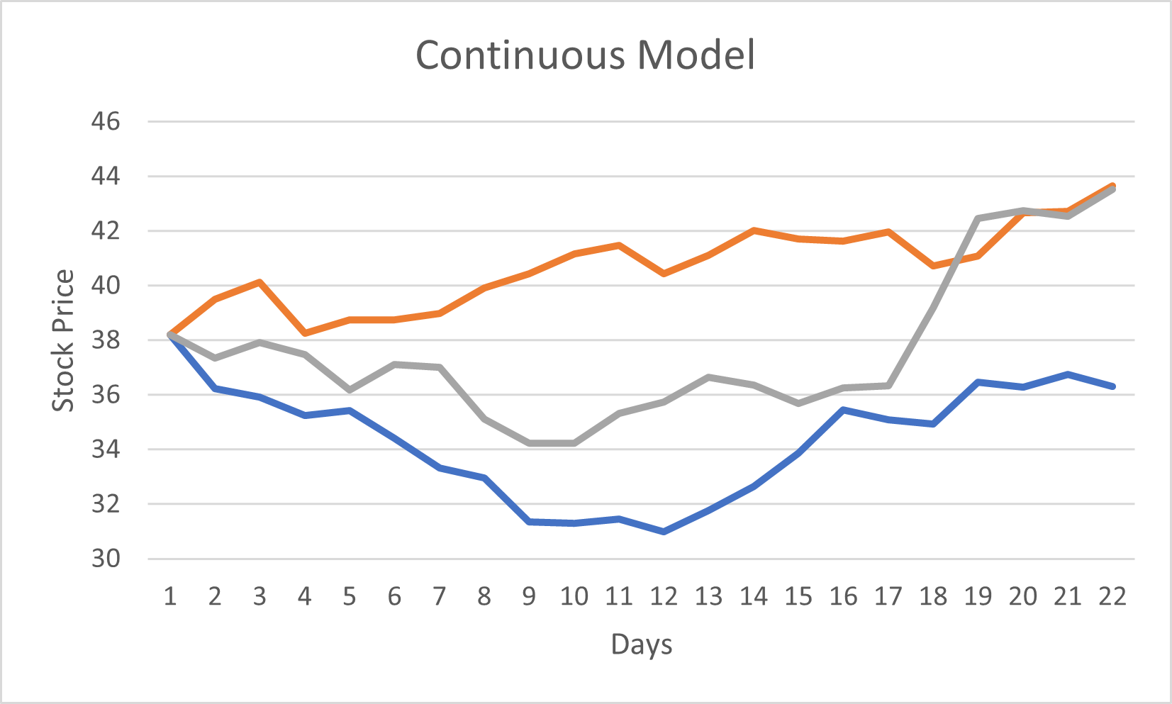
MGM Resorts International(MGM)

Slide 17
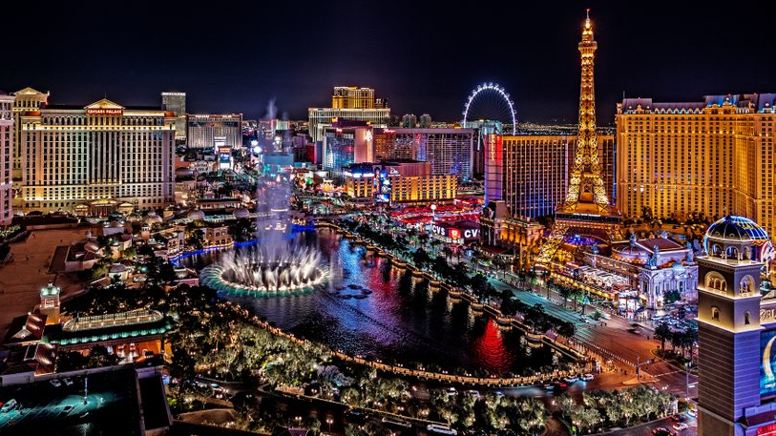
MGM Resorts International(MGM)
After 1000 runs to predict the price of 4/23/21
Discrete Model
Mean: 40.49
Std: 3.31
Continuous Model
Mean: 41.1
Std: 4.75

Slide 18
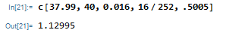
MGM Resorts International(MGM)
Stock Closing Price on 3/31/2019: $37.99
Average Annual Volatility: 50.05%
Risk Free rate of return: 1.6%
T = 16/252
K = 40
Black-Scholes Price: $1.13
Listed price: $0.96
Actual Price of 4/23: $41.05
Gain: 1.05-0.96EXP(0.016*16/365)= 0.09

Slide 19

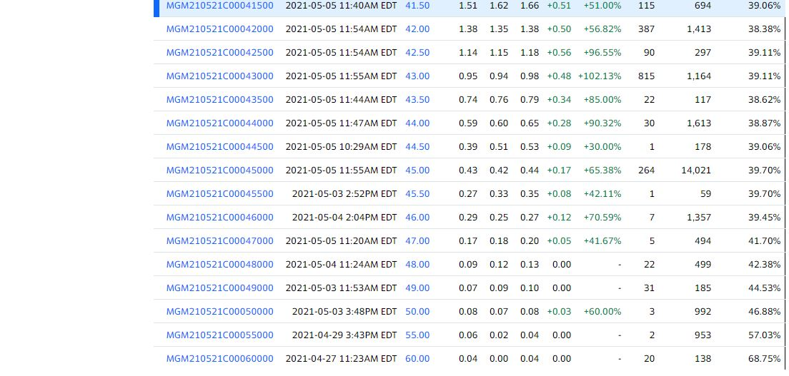
One Recommendation
MGM ($41.81 at screenshot price at 5/4), k=43, t=13/252
1000 runs each models to predict 5/21 price
Discrete Model:
Mean = 43.21 , Std = 2.98
Continuous Model:
Mean = 43.55, Std = 4.26
Black-Scholes: $1.07
List Price: $0.95

Slide 20
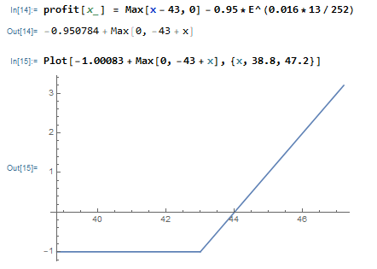
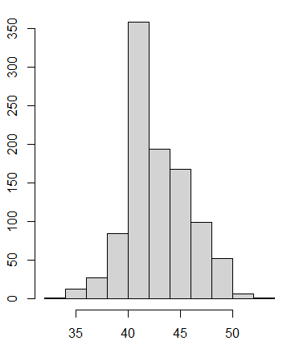
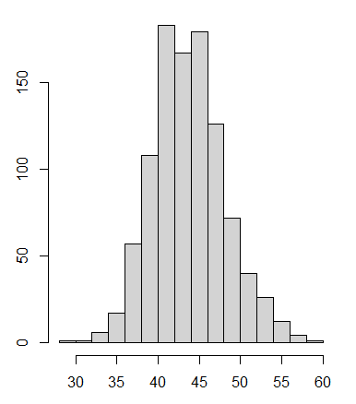
MGM Resorts International(MGM)
Profit
Price
Discrete Model
Continuous Model

Slide 21
Bibliography
Buchanan, J. R. (2012). An Undergraduate Introduction to Financial Mathematics. World Scientific Publishing Co
https://finance.yahoo.com/
https://www.lasvegasnevada.gov/News/Blog/Detail/corona-virus-update

